Slide 1
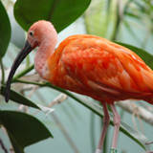
The Scarlet Ibis
By: James Hurst

Slide 2
What is an Ibis?
South American wading bird
Bright red in color with black wing tips
In the same family as the stork and heron
Measures 56 – 58cm in length, and weighs 775 – 925 g.
Juveniles have brown markings on their heads and necks
The Ibis will get darker (red) as it ages

Slide 3
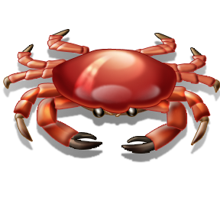
There are over 20 species of the Ibis birds
Birds inhabit tropical South America – the Caribbean
The Ibis is the national bird of Trinidad and Tobago and is featured on their coat of arms
Though abundant in places, their numbers are declining due to the destruction of their habitats, hunting, and excessive use of pesticides
Diet consists of shrimp, crabs, shellfish, and aquatic insects

Slide 4
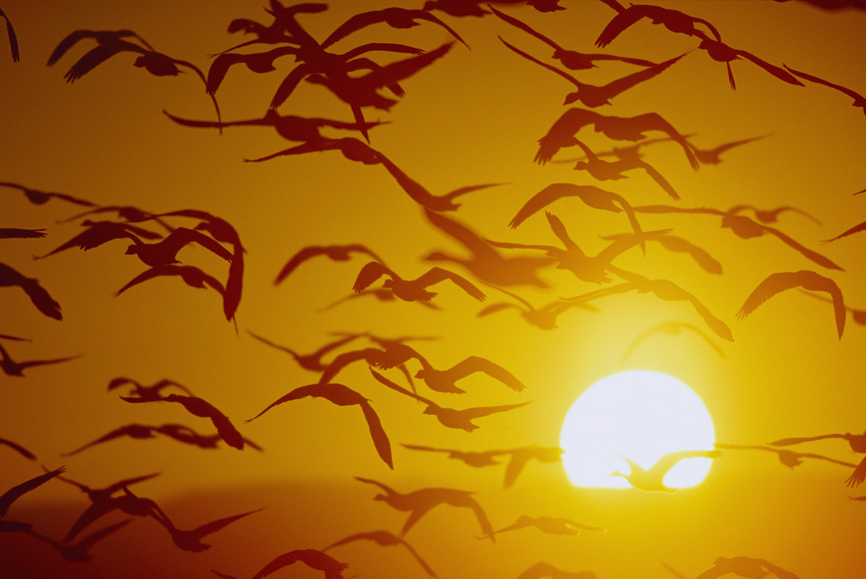
The breeding season is variable but often occurs after heavy rains
They generally lay two eggs, which are incubated for 21 – 23 days
They are social birds that join together to form large flocks in the breeding season often with heron and other birds
Then they all pair off although they mate with more than one individual

Slide 5
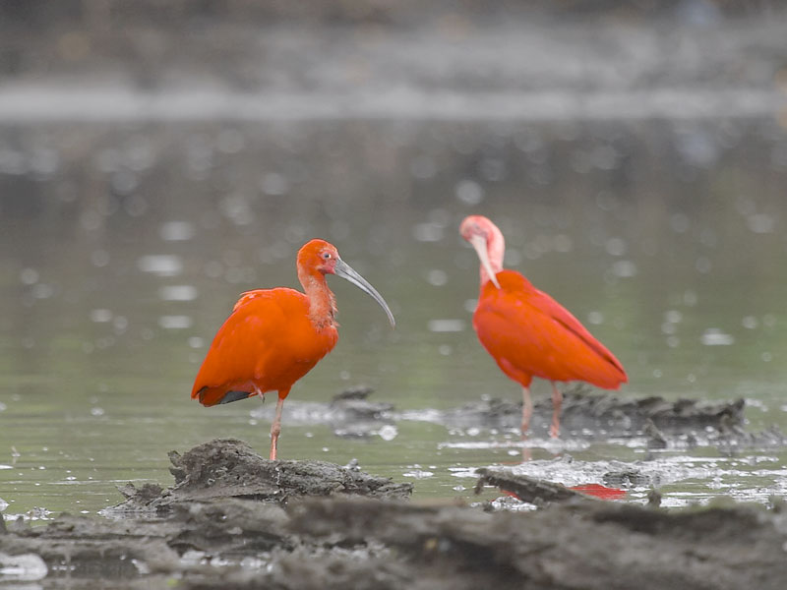

Slide 6
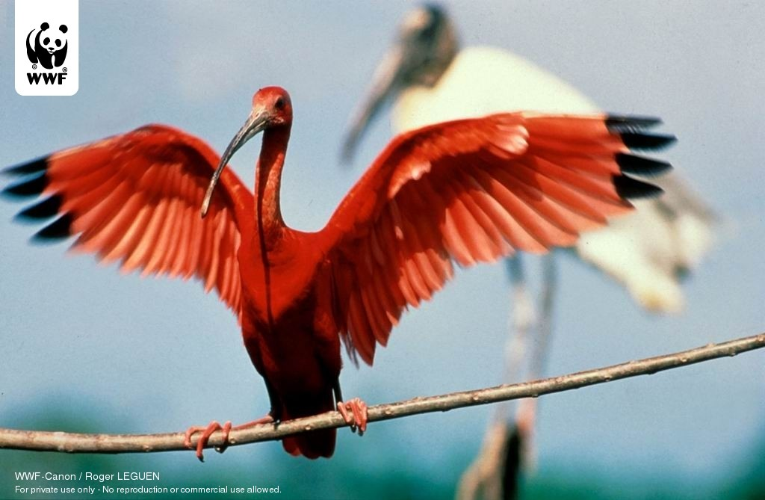

Slide 7
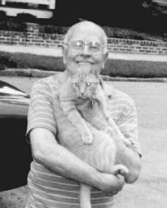
Author Information: James Hurst
Born in 1922
James grew up on a coastal farm in Jacksonville, North Carolina
Served in the army in World War II
Studied to be a chemical engineer
Also studied singing/acting at
Julliard School in New York City
Hurst moved to Italy to pursue a
career in opera but returned after
just three years

Slide 8
When James returned to the United States, he became a banker and remained in that career for 34 years
In his spare time, James wrote plays and short stories, including “The Scarlet Ibis”
He finally retired from banking and returned to North Carolina

Slide 9
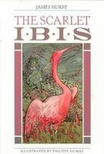
The Story
“The Scarlet Ibis” was first published in
The Atlantic Monthly in July 1960
The story quickly became a classic and
has been seen in almost every high-school literature textbook since the 1960s
Hurst states that the three major characters of this story are Doodle, the narrator, and the setting
When asked what this story is about, he stated, “that it comments on the tenacity and the splendor of the human spirit.”

Slide 10
James Hurst’s Hope
He wants the readers of “The Scarlet Ibis” to think of how the war raging among “brothers” in Europe is related to the conflict between Doodle and his brother.
He reflects, “People always suffer when others try to make them over in their own image.”

Slide 11
“The Scarlet Ibis” and Allegory
Allegory – a story in which characters, settings, and actions stand for something beyond themselves.
An allegory can be read on one level for its literal, straightforward meaning, and on a second level for its symbolic, or allegorical meaning.
Allegories are often intended to teach a moral lesson or to make a comment about goodness and vice.

Slide 12
3 Big Allegorical Ideas
The danger of attempting to make others over in one’s own image
The brotherhood of all mankind
The waste of life resulting from a lack of love and compassion.

Slide 13
“The Scarlet Ibis”
World War I (1914 – 1918)
Significant numbers of American troops were sent to fight in Europe in the summer of 1918 (when the story is set).
Wars fought against other nations necessarily involve attempts to make over other nations in the aggressor’s image.

Slide 14
Prerequisites to such attempts are pride and arrogance: aggressor nation believes it is somehow better than victim nation and that it has the right to change the victim nation
Brotherhood among soldiers fighting in mud-filled trenches is a common theme in war literature – LOYALTY IS VITAL!!
In “The Scarlet Ibis” Hurst emphasizes that the war’s main legacy in the U.S. was the deaths of many men.
Many heroic tales of men risking own lives to save a fallen colleague, or horror stories of wounded men being left to die.

Slide 15
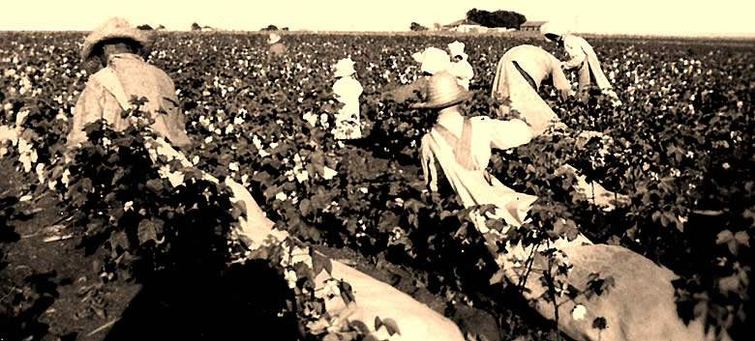
Setting and Tone
Setting - North Carolina; cotton farm; Old Woman Swamp
Tone – author’s attitude; conveyed through author’s choice of words and details

Slide 16
Foreshadowing
The use of clues to hint at events that will occur later in a plot.
Summer of 1918 was blighted – crops withered, curled up, and died
Plant growth was replaced by death and decay
“Dead birds is bad luck…Specially red dead birds!”

Slide 17
Allusion
A reference in a work of literature to a statement or an event from literature, history, religion, mythology, politics, sports, science, or pop culture.
Three allusions in “The Scarlet Ibis”
  Belleau Woods – WWI battle sites
  Hansel and Gretel (bread crumbs)
  The Bible (Resurrection [Aunt Nicey])

Slide 18
Imagery
Descriptive language that deals with any of the five senses (sight, touch, smell, hearing, and taste) and even movement
Helps the reader to create “pictures” in his/her head
The use of figurative language (similes, metaphors, personification) helps create imagery in writing.

Slide 19
Examples (Imagery)
“…with a tiny body that was red and shriveled like an old man’s” – simile (sense of sight)
“…curtains billowed out in the afternoon sea breeze, rustling like Palmetto fronds” – simile (sight and movement)
“Even death did not mar its grace, for it lay on the earth like a broken vase of red flowers.” – simile (sight)
“The [rain] drops stung my face like nettles.” – simile (touch)

Slide 20
Symbols
A symbol is a thing or idea that stands for something else.
grindstone – symbolizes Brother’s memories
Ibis – symbolizes Doodle
Peacock (in Doodle’s lie) – symbolizes Doodle
Old Woman Swamp – symbolizes a place of paradise for the boys
Red – blood, death, bleeding tree, Ibis, Doodle at birth
War – the war between brothers

Slide 21

Theme
Central idea or message in a work of fiction
Themes are timeless and universal
Conflict drives theme – lesson learned by the protagonist…
Themes are expressed in complete sentences
Single words and phrases are “big ideas”

